Slide 1


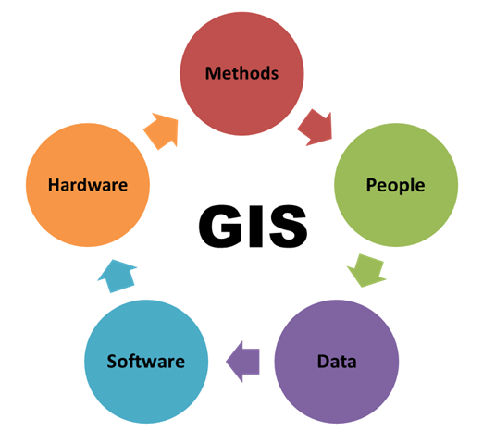
Geographic Information Systems
Version 1.2
2024-03-07 @ 13;55;13

Slide 2
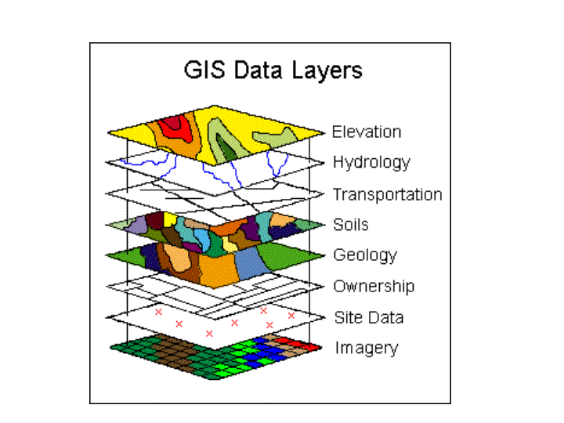
GIS WOT?
What is GIS?
Who wants GIS?
How does GIS work?
Is my cat a psychopath?
vcedata.com slideshow © Mark Kelly 2022 - <number>/35

Slide 3
What is a Geographic Information System (GIS)?
A database of geographic or spatial* data integrated with other data sets
Software tools to manipulate that spatial data
search, sort, visualise, analyse, combine
Related tools and systems, e.g. GPS, satellites, remote sensing
* Spatial data – data related to position
vcedata.com slideshow © Mark Kelly 2022 - <number>/35

Slide 4
What is a Geographic Information System (GIS)?
GIS allows users to
view, understand,
question, interpret, and
visualize data
in many ways that reveal relationships, patterns, and trends in the form of maps, globes, reports, and charts.
A GIS helps users answer questions and solve problems by looking at data in a way that is quickly understood and easily shared
LEENA KANICKARAJ, https://www.arcweb.com
vcedata.com slideshow © Mark Kelly 2022 - <number>/35

Slide 5
What is a Geographic Information System (GIS)?
Database information (attribute data) is linked to spatial data (feature layers) – e.g. schools.
School location = spatial data.
School name, type, size etc = attribute data.
Combining the two data types makes GIS a problem solving tool.
By merging and querying the different layers of the data database, the GIS lets users perform "why" and "what if" scenarios and create a new map showing a visual analysis.
LEENA KANICKARAJ, https://www.arcweb.com
vcedata.com slideshow © Mark Kelly 2022 - <number>/35

Slide 6
What does a GIS need?
Data input
Data storage, retrieval, and query
Data transformation, analysis, and modeling, including spatial statistics
Data reporting, such as maps, reports, and plans
vcedata.com slideshow © Mark Kelly 2022 - <number>/35

Slide 7

Data input from... ?
maps, aerial photos, satellites, surveys, censuses, submarine sensors, GPS data embedded in digital photos, user-supplied data e.g. delivery addresses, radio collars or tags put on wild animals etc
vcedata.com slideshow © Mark Kelly 2022 - <number>/35

Slide 8
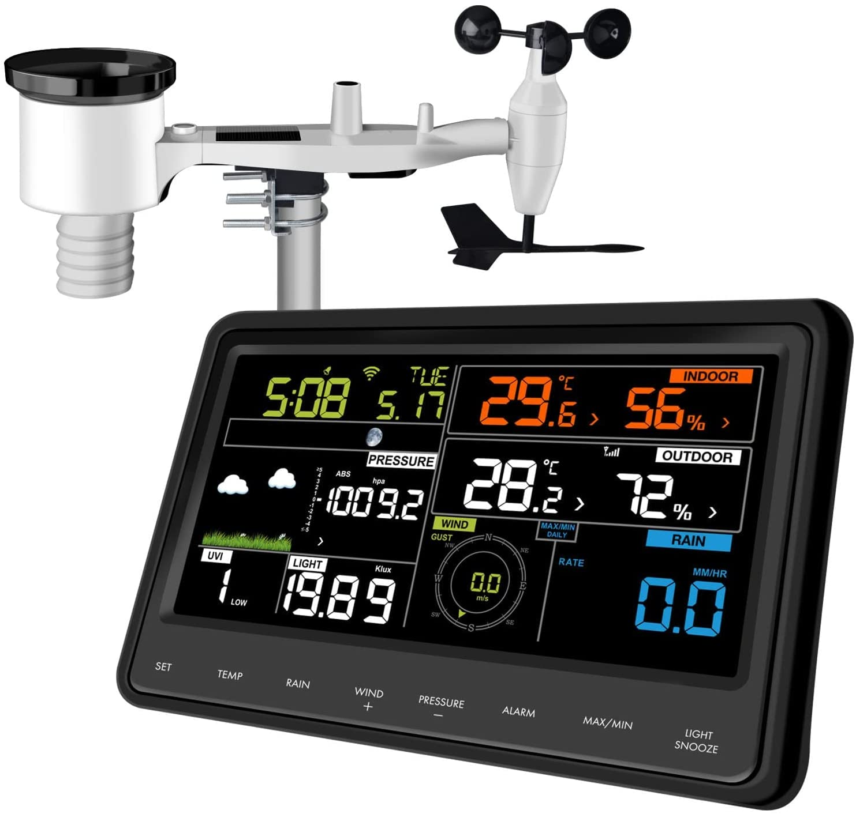
Data from remote sensing*
aerial photography,
spacecraft (e.g. Skylab, ISS), space probes
satellites,
spy planes,
drones,
weather balloons, unmanned weather stations
web cams,
tap on/tap off data from public transport
* identifying, observing, measuring an object without coming into direct contact with it
vcedata.com slideshow © Mark Kelly 2022 - <number>/35

Slide 9
Who uses GIS?
Map makers, GPS systems, military drones, self-driving cars
Insurance companies – want to know where floods, bushfires, avalanches, car accidents etc will be most likely, and set premiums accordingly
Companies planning to set up new shops – where are likely customers living?
e.g. they can estimate a suburb’s wealth by automated counting of swimming pools from satellite photos, or mapping luxury car sales to particular suburbs
vcedata.com slideshow © Mark Kelly 2022 - <number>/35

Slide 10
Who uses GIS?
Governments, to record precise land ownership boundaries
Local councils, to charge rates based on property sizes
Mining companies, to locate resources
Epidemiologists tracking pandemic spread
McDonalds seeking site for new stores
vcedata.com slideshow © Mark Kelly 2022 - <number>/35

Slide 11
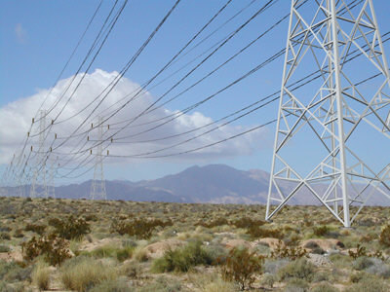
Who uses GIS?
Road, railway developers
High tension electricity power line planners
Sewage system & water supply planners
to find cheap routes for freeways, rail lines, electricity towers, pipes that avoid populated areas or steep gradients
vcedata.com slideshow © Mark Kelly 2022 - <number>/35

Slide 12
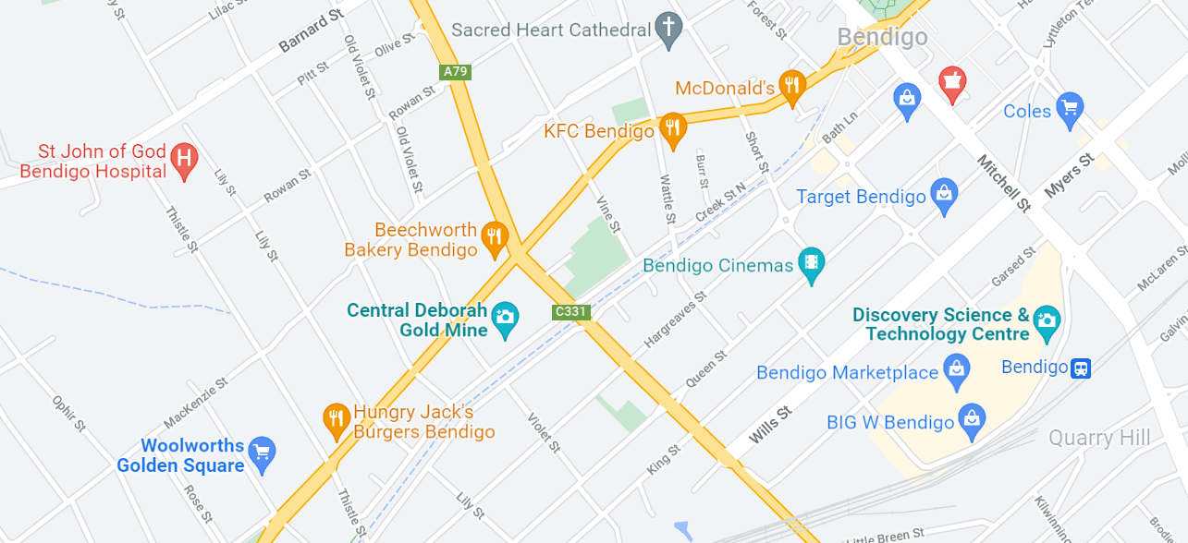
Google maps and their advertisers
vcedata.com slideshow © Mark Kelly 2022 - <number>/35

Slide 13
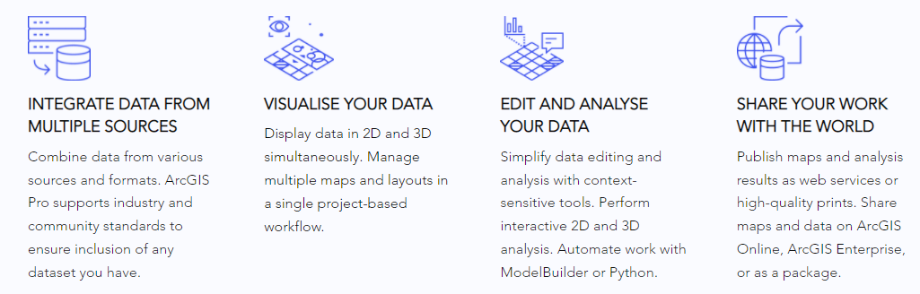
One supplier explains their GIS tool
vcedata.com slideshow © Mark Kelly 2022 - <number>/35

Slide 14
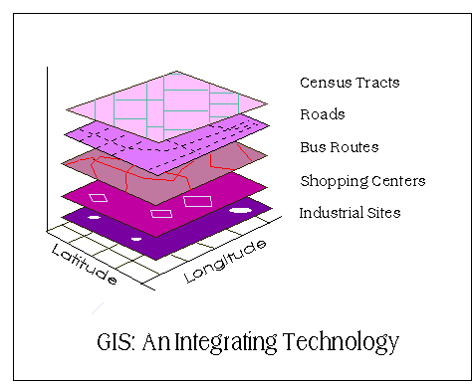
Who uses GIS?
Government planning bodies – where are populations growing or declining that affect the need for resources (schools, hospitals, police, libraries etc), roads, public transport?
Wildlife preservation – monitoring loss or gain of suitable habitat for animals/plants
Telecommunications – where should cell phone / TV repeater towers be put based on distances, elevations, population densities?
Many many others
vcedata.com slideshow © Mark Kelly 2022 - <number>/35

Slide 15
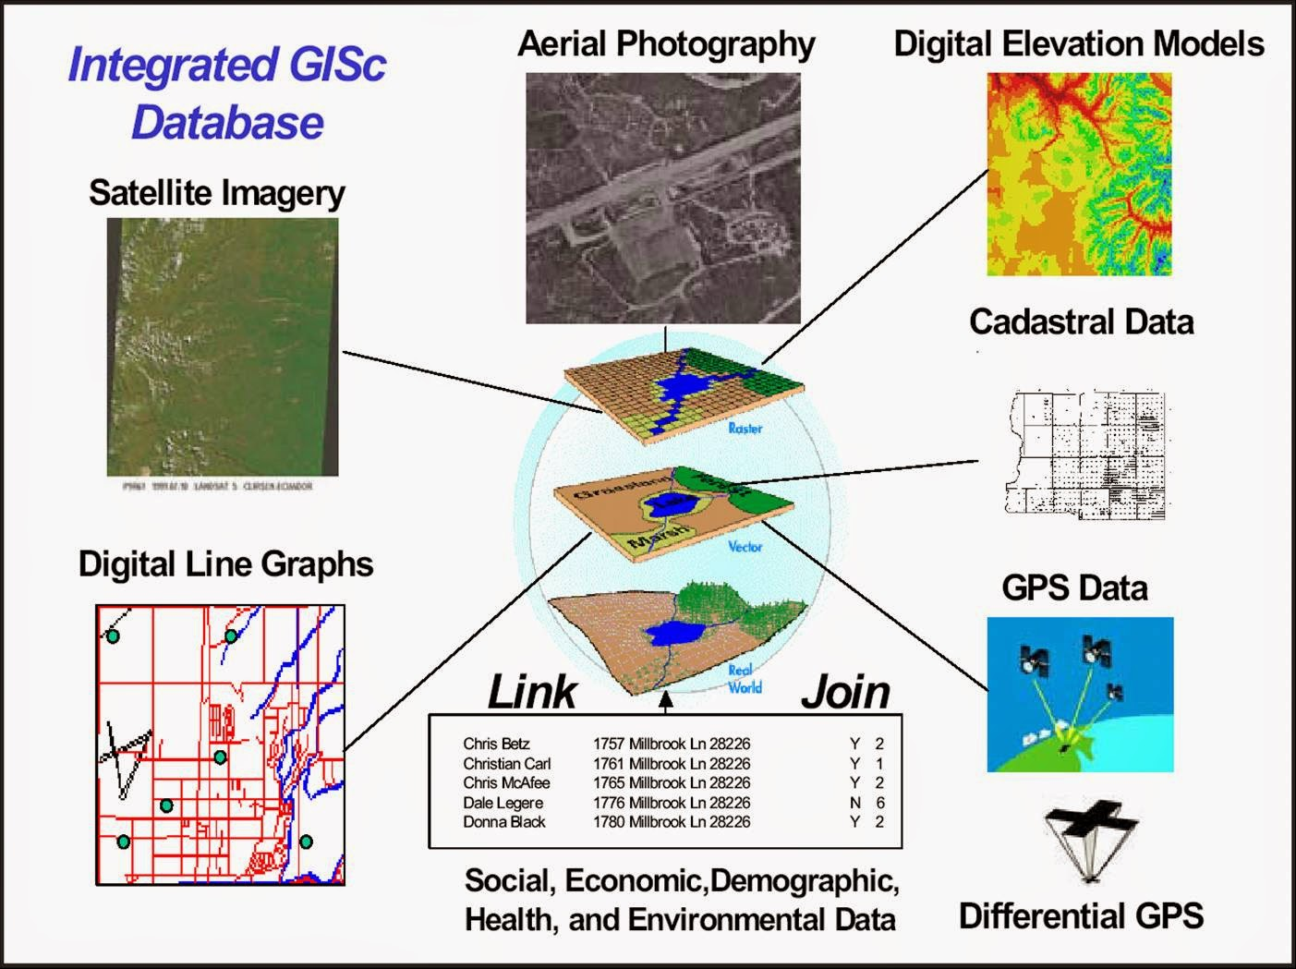
What can GIS offer?
Combining / comparing different data sets
vcedata.com slideshow © Mark Kelly 2022 - <number>/35

Slide 16
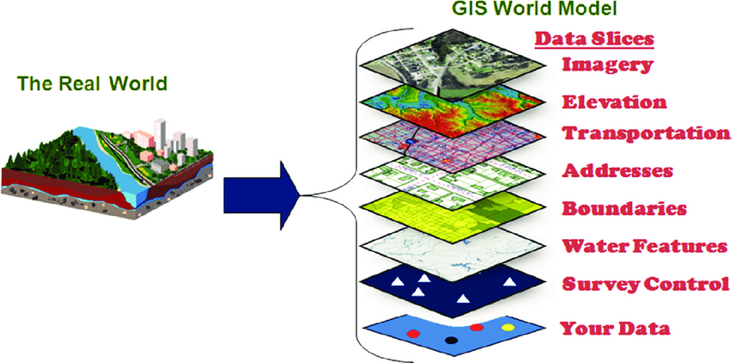
What can GIS offer?
Relating different data sets, e.g. geographic features can be combined with political/social data, or a company’s own data
e.g. We sell diamonds. Some our customers may be worried about “blood diamonds” (look it up). Can we compare our customers’ residential data with the electoral boundaries to see whether we should donate to conservative or liberal political candidates in those electorates who will support diamond sales?
vcedata.com slideshow © Mark Kelly 2022 - <number>/35

Slide 17
What can GIS offer?
An effective GIS will assist the creation of information to provide the evidence and deliver it to decision-makers [your bosses] in an easy-to-understand format.
GIS information helps you source, collate and enhance various different data sets, and present them in a manner that provides insight and clarity to tell compelling stories and support your mission.
vcedata.com slideshow © Mark Kelly 2022 - <number>/35

Slide 18
What can GIS offer?
For example, Crash stats is a dataset published by VicRoads which contains information about reported accidents across Victoria.
Each incident record contains detailed information about the incident such as:
Accident date/time, location
Severity,
victim age and sex,
injuries or deaths,
vehicle type, make and manufacture,
cause of accident,
road surface, weather and lighting conditions
vcedata.com slideshow © Mark Kelly 2022 - <number>/35

Slide 19
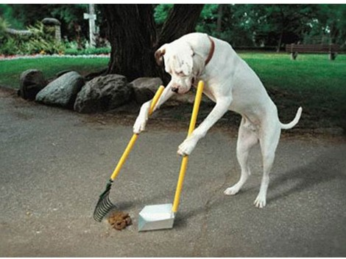
What can GIS offer?
Relating different data sets, e.g. geographic features can be combined with political/social data, or a company’s own data
e.g. Local council could use its dog registration data to map on local geography suitable for dog walking (green areas, beaches, rivers etc) to see where to put dog poo signs, rubbish bins and doggy poo bags.
vcedata.com slideshow © Mark Kelly 2022 - <number>/35

Slide 20
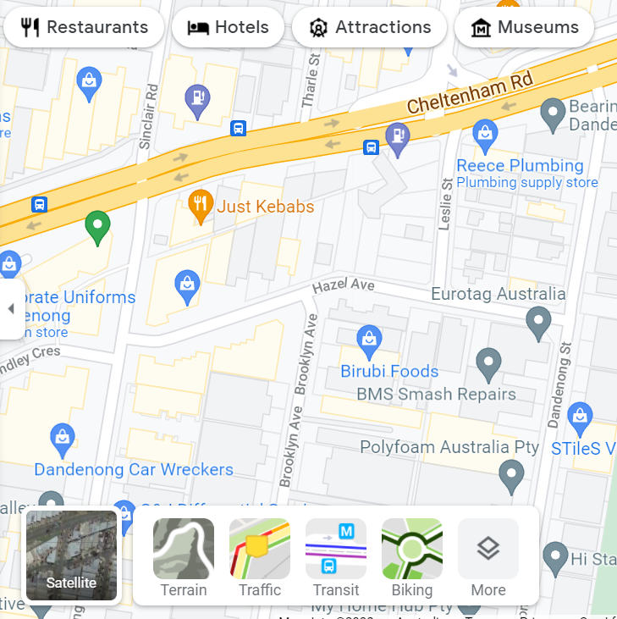
Where do I get GIS?
Google Maps – free for you: paid for by companies adverting their stores overlaid on maps
Data layers
vcedata.com slideshow © Mark Kelly 2022 - <number>/35

Slide 21

Commercial GIS suppliers advertising
- (We) deliver the power of location data in your hand.
- Our reliable, affordable, accessible, high-quality location data covers Australia's 7.6 million km².
- It powers new technologies, products and processes that help improve productivity and stimulate growth.
vcedata.com slideshow © Mark Kelly 2022 - <number>/35

Slide 22

Commercial GIS suppliers advertising
- fuel better business decisions,
- increase efficiency,
- improve communications or
- unlock new revenue streams
vcedata.com slideshow © Mark Kelly 2022 - <number>/35

Slide 23

Commercial GIS suppliers advertising
- fuel better business decisions,
- increase efficiency,
- improve communications or
- unlock new revenue streams
- (we) are reputable, Australian with
ready-to-use data, formatted for GIS.
- our GIS data lets you map & analyse data to understand patterns, correlations and geographic context to improve business outcomes.
vcedata.com slideshow © Mark Kelly 2022 - <number>/35

Slide 24
Commercial GIS suppliers advertising
- our data describes the addresses, land, buildings and transport networks across Australia's 7.6 million km².
- We continuously source, process and deliver data, including APIs and a self-service portal
*API = Application Programming Interface – a way of sharing your database with outsiders - on your own terms.
vcedata.com slideshow © Mark Kelly 2022 - <number>/35

Slide 25
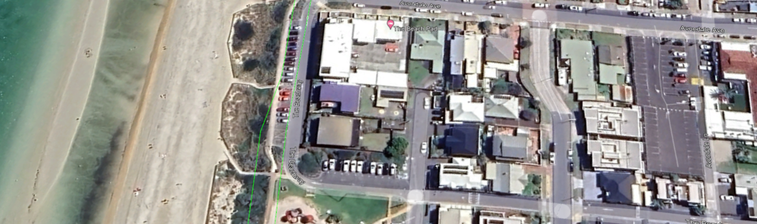
Commercial GIS suppliers advertising
Our data includes:
- Buildings - building outlines for all (15 million+) Australian buildings with a roof area at least 9m²
- You can also select attributes for the buildings, including; Heights, Addresses, Pools, Solar panelling and building footprints.
vcedata.com slideshow © Mark Kelly 2022 - <number>/35

Slide 26
Commercial GIS suppliers advertising
Our data includes:
- Planning data - we provide the Planning attribute for each cadastral parcel* in any selected area.
- It includes information such as Zone Type and Zone Descriptions.
* a public record showing details of land ownership, value, size etc for tax purposes
vcedata.com slideshow © Mark Kelly 2022 - <number>/35

Slide 27

Commercial GIS suppliers advertising
Our APIs* provide:
- Essential location APIs for property developers.
- Our APIs make it easy to spatially enable your applications through address validation and linkage to one of a kind building data.
* Application Program Interface
vcedata.com slideshow © Mark Kelly 2022 - <number>/35

Slide 28
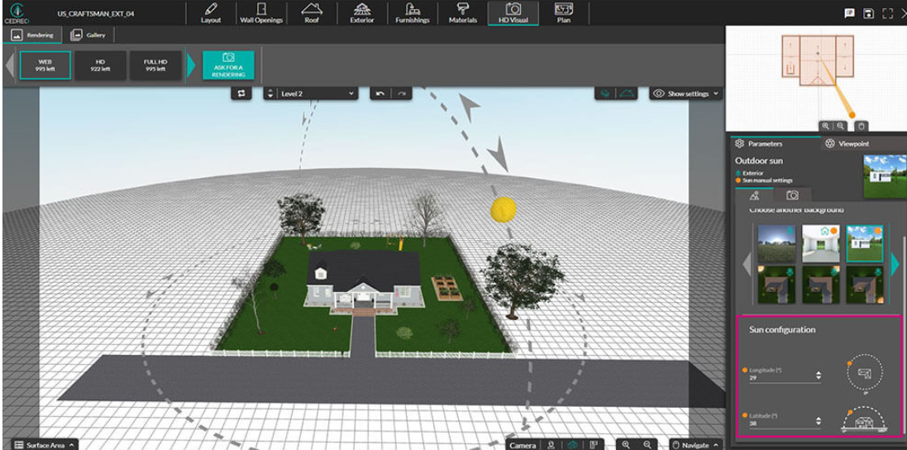
Commercial GIS suppliers advertising
Our APIs* provide:
- Buildings API - Overcome your data sourcing challenges for a multitude of applications including modelling, 3D visualisations and analysis of the built environment.
vcedata.com slideshow © Mark Kelly 2022 - <number>/35

Slide 29
Commercial GIS suppliers advertising
(We) help people transform data into actionable insights. Explore with limitless visual analytics.
Build dashboards and perform ad hoc analyses in just a few clicks.
Share your work with anyone and make an impact on your business.
From global enterprises to early-stage startups and small businesses, people everywhere use (us) to see and understand their data.
Perform detailed analysis using demographic data and built-in mapping capabilities
Present enormous countrywide datasets clearly and allow drill-down to local areas
vcedata.com slideshow © Mark Kelly 2022 - <number>/35

Slide 30
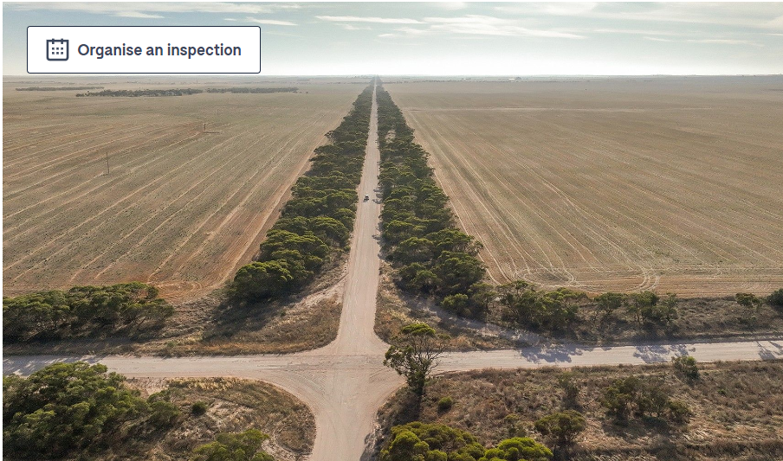
Commercial GIS suppliers advertising
Analyse geographical buying behaviour based on product types
Identify and mitigate risk and efficiencies across geographies
Analyse revenue and profit by region
vcedata.com slideshow © Mark Kelly 2022 - <number>/35

Slide 31
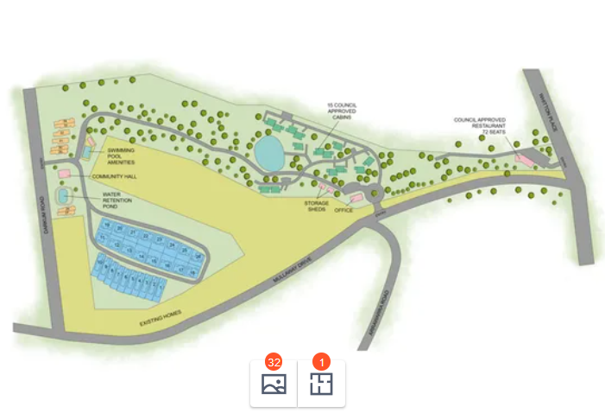
Commercial GIS suppliers advertising
A happy customer said:
When you see the data on the map, you can actually see what it means and what the different regions are
vcedata.com slideshow © Mark Kelly 2022 - <number>/35

Slide 32
Some interesting GIS videos – commercial and otherwise
(internet required)
- satellite imagery and remote access (Length 2:34) (Dated 2019)
- Spatial analysis with Arc GIS (2:20) (2018)
- Intro to GIS: Geo Info Systems Fundamentals (2:46) (2014)
- How one NASA image tells dozens of stories (5:42) (2019)
- How To Do Aerial Archaeology From Your Home (6:34) (2020)
- Intro to GIS and Science (9:59) (2012)
Email mark@vcedata.com to let me know of other good, short GIS videos
Also please tell me if any of the above links die
vcedata.com slideshow © Mark Kelly 2022 - <number>/35

Slide 33
Places for further research and datasets
http://services.ga.gov.au – Aust govt geoscience data services
https://data.gov.au/ - govt data sets online
https://www.gislounge.com/ - GIS data introduction
https://www.geoscience.gov.au/web-services
https://esriaustralia.com.au – a sample GIS software supplier
vcedata.com slideshow © Mark Kelly 2022 - <number>/35

Slide 34
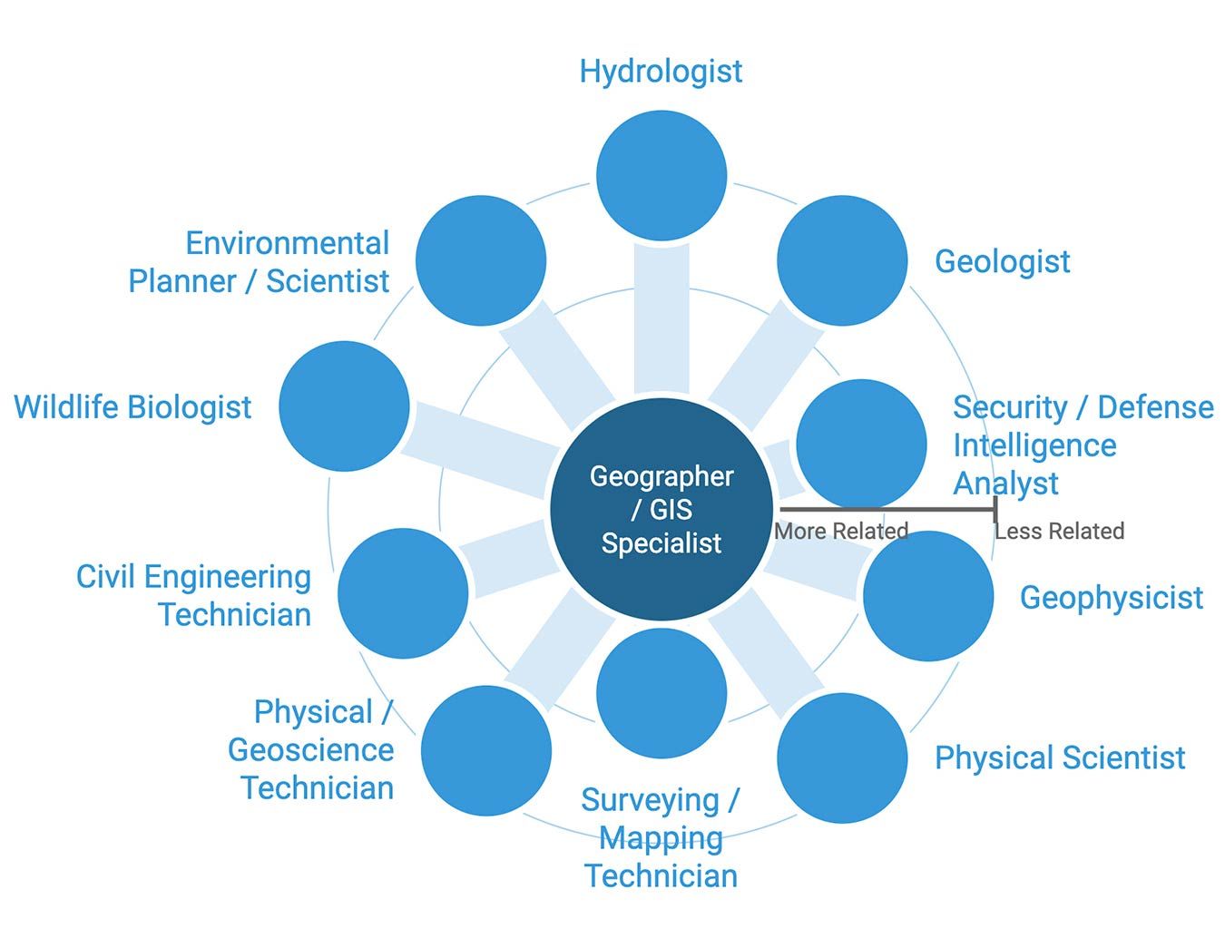
A final thought...
GIS seems to be the elephant in the ICT room.
It includes nearly all computer/communication/scientific/social areas of study and expertise.
It is BIG BUSINESS, and is growing.
And people are passionate about it.
You might want to consider it as a career path, regardless of your skill set.
vcedata.com slideshow © Mark Kelly 2022 - <number>/35

Slide 35
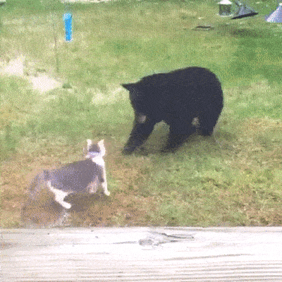
These slideshows may be freely used, modified or distributed by teachers and students anywhere.
They may not be sold
You must not change or remove their authorship information or copyright notices.
You must not redistribute them if you modify them.
This is not a VCAA publication and does not speak for VCAA.
Portions (e.g. exam questions, study design extracts, glossary terms) may be copyright Victorian Curriculum and Assessment Authority and are used with permission for educational purposes.

